Slide 1
The Collections Framework:
The java.util package also contains one of Java’s most powerful subsystems: the Collections Framework.
The Collection in Java is a framework that provides an architecture to store and manipulate the group of objects.
Java Collections can achieve all the operations that you perform on a data such as searching, sorting, insertion, manipulation, and deletion.
ACE Engineering College

Slide 2
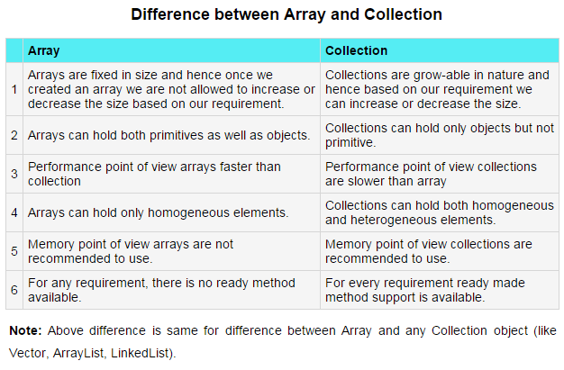
ACE Engineering College

Slide 3
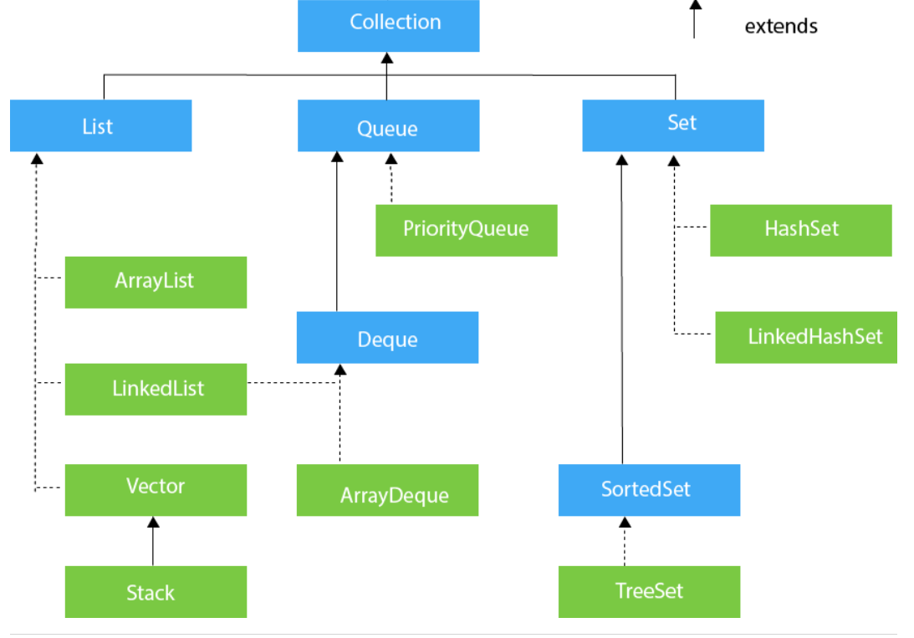
ACE Engineering College

Slide 4
Java ArrayList
class uses a dynamic array for storing the elements. It is like an array, but there is no size limit. We can add or remove elements anytime. So, it is much more flexible than the traditional array. It is found in the java.util package.
The ArrayList in Java can have the duplicate elements also. It implements the List interface so we can use all the methods of the List interface here. The ArrayList maintains the insertion order internally.
The important points about the Java ArrayList class are:
Java ArrayList class can contain duplicate elements.
Java ArrayList class maintains insertion order.
Java ArrayList class is non synchronized.
Java ArrayList allows random access because the array works on an index basis.
In ArrayList, manipulation is a little bit slower than the LinkedList in Java because a lot of shifting needs to occur if any element is removed from the array list.
We can not create an array list of the primitive types, such as int, float, char, etc. It is required to use the required wrapper class in such cases
ArrayList<int> al = ArrayList<int>(); // does not work
ArrayList<Integer> al = new ArrayList<Integer>(); // works fine
ACE Engineering College

Slide 5
Method | Description
void add(int index, E element) | It is used to insert the specified element at the specified position in a list.
boolean add(E e) | It is used to append the specified element at the end of a list.
boolean addAll(Collection<? extends E> c) | It is used to append all of the elements in the specified collection to the end of this list, in the order that they are returned by the specified collection's iterator.
boolean addAll(int index, Collection<? extends E> c) | It is used to append all the elements in the specified collection, starting at the specified position of the list.
void clear() | It is used to remove all of the elements from this list.
ACE Engineering College

Slide 6
import java.util.*;
public class ArrayListExample1{
public static void main(String args[]){
ArrayList<String> list=new ArrayList<String>();//Creating arraylist
list.add("Mango");//Adding object in arraylist
list.add("Apple");
list.add("Banana");
list.add("Grapes");
//Printing the arraylist object
System.out.println(list);
}
}
ACE Engineering College

Slide 7
ArrayList | LinkedList
1) ArrayList internally uses a dynamic array to store the elements. | LinkedList internally uses a doubly linked list to store the elements.
2) Manipulation with ArrayList is slow because it internally uses an array. If any element is removed from the array, all the other elements are shifted in memory. | Manipulation with LinkedList is faster than ArrayList because it uses a doubly linked list, so no bit shifting is required in memory.
3) An ArrayList class can act as a list only because it implements List only. | LinkedList class can act as a list and queue both because it implements List and Deque interfaces.
4) ArrayList is better for storing and accessing data. | LinkedList is better for manipulating data.
5) The memory location for the elements of an ArrayList is contiguous. | The location for the elements of a linked list is not contagious.
6) Generally, when an ArrayList is initialized, a default capacity of 10 is assigned to the ArrayList. | There is no case of default capacity in a LinkedList. In LinkedList, an empty list is created when a LinkedList is initialized.
7) To be precise, an ArrayList is a resizable array. | LinkedList implements the doubly linked list of the list interface.
ACE Engineering College

Slide 8
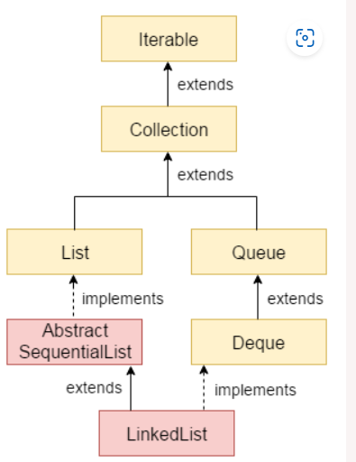

Java LinkedList
class uses a doubly linked list to store the elements. It provides a linked-list data structure. It inherits the AbstractList class and implements List and Deque interfaces.
The important points about Java LinkedList are:
Java LinkedList class can contain duplicate elements.
Java LinkedList class maintains insertion order.
Java LinkedList class is non synchronized.
In Java LinkedList class, manipulation is fast because no shifting needs to occur.
Java LinkedList class can be used as a list, stack or queue.
Doubly Linked List
In the case of a doubly linked list, we can add or remove elements from both sides.
ACE Engineering College

Slide 9
Constructor | Description
LinkedList() | It is used to construct an empty list.
LinkedList(Collection<? extends E> c) | It is used to construct a list containing the elements of the specified collection, in the order, they are returned by the collection's iterator.
ACE Engineering College

Slide 10
Method | Description
boolean add(E e) | It is used to append the specified element to the end of a list.
void add(int index, E element) | It is used to insert the specified element at the specified position index in a list.
boolean addAll(Collection<? extends E> c) | It is used to append all of the elements in the specified collection to the end of this list, in the order that they are returned by the specified collection's iterator.
ACE Engineering College

Slide 11
import java.util.*;
public class LinkedList1{
public static void main(String args[]){
LinkedList<String> al=new LinkedList<String>();
al.add("Ravi");
al.add("Vijay");
al.addLast("Z");
al.addFirst("A");
al.remove(“Z”);
al.remove(2);
al.removeFirst();
al.removeLast();
Iterator<String> itr=al.iterator();
while(itr.hasNext()){
System.out.println(itr.next());
}
}
}
Output: Ravi
Vijay
Ravi
Ajay
ACE Engineering College

Slide 12
List | Set
1. The List is an indexed sequence. | 1. The Set is an non-indexed sequence.
2. List allows duplicate elements | 2. Set doesn't allow duplicate elements.
3. Elements by their position can be accessed. | 3. Position access to elements is not allowed.
ACE Engineering College

Slide 13
The HashSet
Class HashSet extends AbstractSet and implements the Set interface. It creates a collection that uses a hash table for storage.
The important points about Java HashSet class are:
HashSet stores the elements by using a mechanism called hashing.
HashSet contains unique elements only.
HashSet allows null value.
HashSet class is non synchronized.
HashSet doesn't maintain the insertion order. Here, elements are inserted on the basis of their hashcode.
HashSet is the best approach for search operations.
The initial default capacity of HashSet is 16, and the load factor is 0.75.
// Demonstrate HashSet.
import java.util.*;
class HashSetDemo {
public static void main(String args[]) {
// Create a hash set.
HashSet<String> hs = new HashSet<String>();
// Add elements to the hash set.
ACE Engineering College

Slide 14
hs.add("Beta");
hs.add("Alpha");
hs.add("Eta");
hs.add("Gamma");
hs.add("Epsilon");
hs.add("Omega");
System.out.println(hs);
}
}
The following is the output from this program:
[Gamma, Eta, Alpha, Epsilon, Omega, Beta]
ACE Engineering College

Slide 15
The LinkedHashSet :
Class The LinkedHashSet class extends HashSet and adds no members of its own.
LinkedHashSet maintains a linked list of the entries in the set, in the order in which they were inserted. This allows insertion-order iteration over the set. That is, when cycling through a LinkedHashSet using an iterator, the elements will be returned in the order in which they were inserted.
The output will be
[Beta, Alpha, Eta, Gamma, Epsilon, Omega]
which is the order in which the elements were inserted.
ACE Engineering College

Slide 16
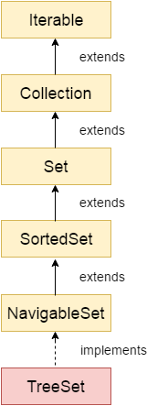
Java TreeSet
class implements the Set interface that uses a tree for storage. It inherits AbstractSet class and implements the NavigableSet interface. The objects of the TreeSet class are stored in ascending order.
The important points about the Java TreeSet class are:
Java TreeSet class contains unique elements only like HashSet.
Java TreeSet class access and retrieval times are quiet fast.
Java TreeSet class doesn't allow null element.
Java TreeSet class is non synchronized.
Java TreeSet class maintains ascending order.
Java TreeSet class contains unique elements only like HashSet.
Java TreeSet class access and retrieval times are quite fast.
The TreeSet can only allow those generic types that are comparable.
For example The Comparable interface is being implemented by the StringBuffer class.
ACE Engineering College

Slide 17
import java.util.*;
class TreeSet1{
public static void main(String args[]){
//Creating and adding elements
TreeSet<String> al=new TreeSet<String>();
al.add("Ravi");
al.add("Vijay");
al.add("Ravi");
al.add("Ajay");
//Traversing elements
Iterator<String> itr=al.iterator();
while(itr.hasNext()){
System.out.println(itr.next());
}
}
o/p:
Ajay
Ravi
Vijay
ACE Engineering College

Slide 18
import java.util.*;
class TreeSet2{
public static void main(String args[]){
TreeSet<String> set=new TreeSet<String>();
set.add("Ravi");
set.add("Vijay");
set.add("Ajay");
System.out.println("Traversing element through Iterator in descending order");
Iterator i=set.descendingIterator();
while(i.hasNext())
{
System.out.println(i.next());
}
}
}
o/p:
Traversing element through Iterator in descending order
Vijay
Ravi
Ajay
Traversing element through NavigableSet in descending order
Vijay
Ravi
Ajay
ACE Engineering College

Slide 19
Java Queue Interface
The interface Queue is available in the java.util package and does extend the Collection interface. It is used to keep the elements that are processed in the First In First Out (FIFO) manner.
Features of a Queue
The following are some important features of a queue.
As discussed earlier, FIFO concept is used for insertion and deletion of elements from a queue.
The Java Queue provides support for all of the methods of the Collection interface including deletion, insertion, etc.
PriorityQueue, ArrayBlockingQueue and LinkedList are the implementations that are used most frequently.
The NullPointerException is raised, if any null operation is done on the BlockingQueues.
Those Queues that are present in the util package are known as Unbounded Queues.
Those Queues that in theare present util.concurrent package are known as bounded Queues.
All Queues barring the Deques facilitates removal and insertion at the head and tail of the queue; respectively. In fact, deques support element insertion and removal at both ends.
ACE Engineering College

Slide 20
PriorityQueue Class
PriorityQueue is also class that is defined in the collection framework that gives us a way for processing the objects on the basis of priority. It is already described that the insertion and deletion of objects follows FIFO pattern in the Java queue. However, sometimes the elements of the queue are needed to be processed according to the priority, that's where a PriorityQueue comes into action.
import java.util.*;
class TestCollection12{
public static void main(String args[]){
PriorityQueue<String> queue=new PriorityQueue<String>();
queue.add("Amit");
queue.add("Vijay");
queue.add("Karan");
queue.add("Jai");
queue.add("Rahul");
System.out.println("head:"+queue.element());
System.out.println("head:"+queue.peek());
System.out.println("iterating the queue elements:");
Iterator itr=queue.iterator();
ACE Engineering College

Slide 21
while(itr.hasNext()){
System.out.println(itr.next());
}
queue.remove();
queue.poll();
System.out.println("after removing two elements:");
Iterator<String> itr2=queue.iterator();
while(itr2.hasNext()){
System.out.println(itr2.next());
}
}
}
o/p:
head:Amit
head:Amit
iterating the queue elements:
Amit
Jai
Karan
Vijay
Rahul
after removing two elements:
Karan
Rahul
Vijay
ACE Engineering College

Slide 22
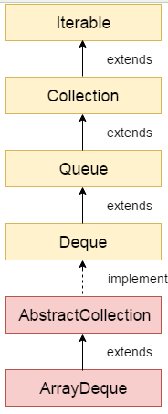
Java Deque Interface
The interface called Deque is present in java.util package. It is the subtype of the interface queue. The Deque supports the addition as well as the removal of elements from both ends of the data structure. Therefore, a deque can be used as a stack or a queue. We know that the stack supports the Last In First Out (LIFO) operation, and the operation First In First Out is supported by a queue. As a deque supports both, either of the mentioned operations can be performed on it. Deque is an acronym for "double ended queue".
ArrayDeque class
We know that it is not possible to create an object of an interface in Java. Therefore,
for instantiation, we need a class that implements the Deque interface,
and that class is ArrayDeque. It grows and shrinks as per usage.
It also inherits the AbstractCollection class.
ACE Engineering College

Slide 23
The important points about ArrayDeque class are:
Unlike Queue, we can add or remove elements from both sides.
Null elements are not allowed in the ArrayDeque.
ArrayDeque is not thread safe, in the absence of external synchronization.
ArrayDeque has no capacity restrictions.
ArrayDeque is faster than LinkedList and Stack.
Java ArrayDeque Example
import java.util.*;
public class ArrayDequeExample {
public static void main(String[] args) {
//Creating Deque and adding elements
Deque<String> deque = new ArrayDeque<String>();
deque.add("Ravi");
deque.add("Vijay");
deque.add("Ajay");
//Traversing elements
for (String str : deque) {
System.out.println(str);
}
}
}
ACE Engineering College

Slide 24
import java.util.*;
public class DequeExample {
public static void main(String[] args) {
Deque<String> deque=new ArrayDeque<String>();
deque.offer("arvind");
deque.offer("vimal");
deque.add("mukul");
deque.offerFirst("jai");
System.out.println("After offerFirst Traversal...");
for(String s:deque){
System.out.println(s);
}
//deque.poll();
//deque.pollFirst();//it is same as poll()
deque.pollLast();
System.out.println("After pollLast() Traversal...");
for(String s:deque){
System.out.println(s);
}
}
}
Output:
After offerFirst Traversal...
jai
arvind
vimal
mukul
After pollLast() Traversal...
jai
arvind
vimal
ACE Engineering College

Slide 25
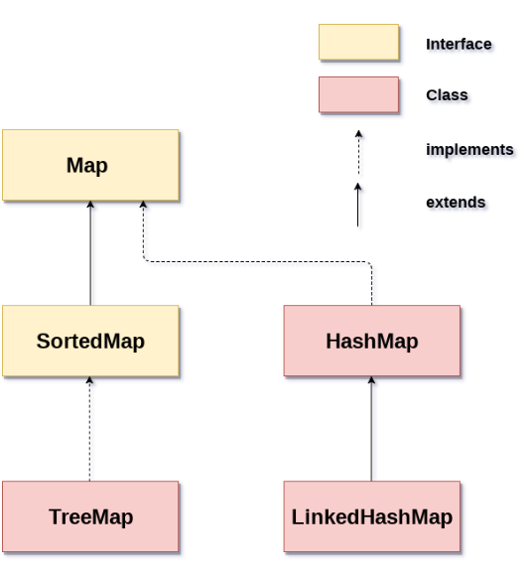
Java Map Interface
A map contains values on the basis of key, i.e. key and value pair.
Each key and value pair is known as an entry.
A Map contains unique keys.
A Map is useful if you have to search,
update or delete elements on the basis of a key.
There are two interfaces for implementing Map in java: Map and SortedMap, and three classes: HashMap, LinkedHashMap, and TreeMap. The hierarchy of Java Map is given below:
A Map doesn't allow duplicate keys, but you can have duplicate values. HashMap and LinkedHashMap allow null keys and values, but TreeMap doesn't allow any null key or value.
Java Map Hierarchy
ACE Engineering College

Slide 26
A Map can't be traversed, so you need to convert it into Set using keySet() or entrySet() method.
Class | Description
HashMap | HashMap is the implementation of Map, but it doesn't maintain any order.
LinkedHashMap | LinkedHashMap is the implementation of Map. It inherits HashMap class. It maintains insertion order.
TreeMap | TreeMap is the implementation of Map and SortedMap. It maintains ascending order.
ACE Engineering College

Slide 27
Useful methods of Map interface
Method | Description
V put(Object key, Object value) | It is used to insert an entry in the map.
void putAll(Map map) | It is used to insert the specified map in the map.
V putIfAbsent(K key, V value) | It inserts the specified value with the specified key in the map only if it is not already specified.
V remove(Object key) | It is used to delete an entry for the specified key.
boolean remove(Object key, Object value) | It removes the specified values with the associated specified keys from the map.
Set keySet() | It returns the Set view containing all the keys.
Set<Map.Entry<K,V>> entrySet() | It returns the Set view containing all the keys and values.
void clear() | It is used to reset the map.
ACE Engineering College

Slide 28
Map.Entry Interface
Entry is the subinterface of Map. So we will be accessed it by Map.Entry name. It returns a collection-view of the map, whose elements are of this class. It provides methods to get key and value.
Methods of Map.Entry interface
Method | Description
K getKey() | It is used to obtain a key.
V getValue() | It is used to obtain value.
int hashCode() | It is used to obtain hashCode.
V setValue(V value) | It is used to replace the value corresponding to this entry with the specified value.
ACE Engineering College

Slide 29
import java.util.*;
public class MapExample1 {
public static void main(String[] args) {
Map map=new HashMap();
//Adding elements to map
map.put(1,"Amit");
map.put(5,"Rahul");
map.put(2,"Jai");
map.put(6,"Amit");
//Traversing Map
Set set=map.entrySet();//Converting to Set so that we can traverse
Iterator itr=set.iterator();
while(itr.hasNext()){
//Converting to Map.Entry so that we can get key and value separately
Map.Entry entry=(Map.Entry)itr.next();
System.out.println(entry.getKey()+" "+entry.getValue());
}
}
}
Output:
1 Amit
2 Jai
5 Rahul
6 Amit
ACE Engineering College

Slide 30
import java.util.*;
class MapExample2{
public static void main(String args[]){
Map<Integer,String> map=new HashMap<Integer,String>();
map.put(100,"Amit");
map.put(101,"Vijay");
map.put(102,"Rahul");
//Elements can traverse in any order
for(Map.Entry m:map.entrySet()){
System.out.println(m.getKey()+" "+m.getValue());
}
}
}
Output:
102 Rahul
100 Amit
101 Vijay
ACE Engineering College

Slide 31
Java Iterator Interface:
In Java, the Iterator interface provides methods that can be used to access elements of collections. To learn more, visit Java Iterator Interface
Iterator interface
Iterator interface provides the facility of iterating the elements in a forward direction only.
Methods of Iterator interface:
There are only three methods in the Iterator interface. They are:
Method | Description
public boolean hasNext() | It returns true if the iterator has more elements otherwise it returns false.
public Object next() | It returns the element and moves the cursor pointer to the next element.
public void remove() | It removes the last elements returned by the iterator. It is less used.
ACE Engineering College

Slide 32
Iterable Interface:
The Iterable interface is the root interface for all the collection classes. The Collection interface extends the Iterable interface and therefore all the subclasses of Collection interface also implement the Iterable interface.
It contains only one abstract method. i.e.,
Iterator<T> iterator()
It returns the iterator over the elements of type T.
Collection Interface
The Collection interface is the interface which is implemented by all the classes in the collection framework. It declares the methods that every collection will have. In other words, we can say that the Collection interface builds the foundation on which the collection framework depends.
Some of the methods of Collection interface are Boolean add ( Object obj), Boolean addAll ( Collection c), void clear(), etc. which are implemented by all the subclasses of Collection interface.
ACE Engineering College

Slide 33
Java Vector:
The Vector class is an implementation of the List interface that allows us to create resizable-arrays similar to the ArrayList class.
Java Vector vs. ArrayList
In Java, both ArrayList and Vector implements the List interface and provides the same functionalities. However, there exist some differences between them.
The Vector class synchronizes each individual operation. This means whenever we want to perform some operation on vectors, the Vector class automatically applies a lock to that operation.
It is because when one thread is accessing a vector, and at the same time another thread tries to access it, an exception called ConcurrentModificationException is generated. Hence, this continuous use of lock for each operation makes vectors less efficient.
However, in array lists, methods are not synchronized. Instead, it uses the Collections.synchronizedList() method that synchronizes the list as a whole.
Note: It is recommended to use ArrayList in place of Vector because vectors less efficient.
ACE Engineering College

Slide 34
Creating a Vector
Here is how we can create vectors in Java.
Vector<Type> vector = new Vector<>();
Here, Type indicates the type of a linked list. For example,
// create Integer type linked list
Vector<Integer> vector= new Vector<>();
// create String type linked list
Vector<String> vector= new Vector<>();
Methods of Vector
The Vector class also provides the resizable-array implementations of the List interface (similar to the ArrayList class). Some of the Vector methods are:
Add Elements to Vector
• add(element) - adds an element to vectors
• add(index, element) - adds an element to the specified position
• addAll(vector) - adds all elements of a vector to another vector
ACE Engineering College

Slide 35
import java.util.Vector;
class Main {
public static void main(String[] args) {
Vector<String> mammals= new Vector<>();
// Using the add() method
mammals.add("Dog");
mammals.add("Horse");
// Using index number
mammals.add(2, "Cat");
System.out.println("Vector: " + mammals);
// Using addAll()
Vector<String> animals = new Vector<>();
animals.add("Crocodile");
animals.addAll(mammals);
System.out.println("New Vector: " + animals);
}
}
Output
Vector: [Dog, Horse, Cat]
New Vector: [Crocodile, Dog, Horse, Cat]
ACE Engineering College

Slide 36
Access Vector Elements
• get(index) - returns an element specified by the index
• iterator() - returns an iterator object to sequentially access vector elements
For example,
import java.util.Iterator;
import java.util.Vector;
class Main {
public static void main(String[] args) {
Vector<String> animals= new Vector<>();
animals.add("Dog");
animals.add("Horse");
animals.add("Cat");
// Using get()
String element = animals.get(2);
System.out.println("Element at index 2: " + element);
// Using iterator()
Iterator<String> iterate = animals.iterator();
ACE Engineering College

Slide 37
Output
Element at index 2: Cat
Vector: Dog, Horse, Cat,
System.out.print("Vector: ");
while(iterate.hasNext()) {
System.out.print(iterate.next());
System.out.print(", ");
}
}
}
Remove Vector Elements
• remove(index) - removes an element from specified position
• removeAll() - removes all the elements
• clear() - removes all elements. It is more efficient than removeAll()
ACE Engineering College

Slide 38
import java.util.Vector;
class Main {
public static void main(String[] args) {
Vector<String> animals= new Vector<>();
animals.add("Dog");
animals.add("Horse");
animals.add("Cat");
System.out.println("Initial Vector: " + animals);
// Using remove()
String element = animals.remove(1);
System.out.println("Removed Element: " + element);
System.out.println("New Vector: " + animals);
// Using clear()
animals.clear();
System.out.println("Vector after clear(): " + animals);
}
}
Output
Initial Vector: [Dog, Horse, Cat]
Removed Element: Horse
New Vector: [Dog, Cat]
Vector after clear(): []
Others Vector Methods
ACE Engineering College

Slide 39
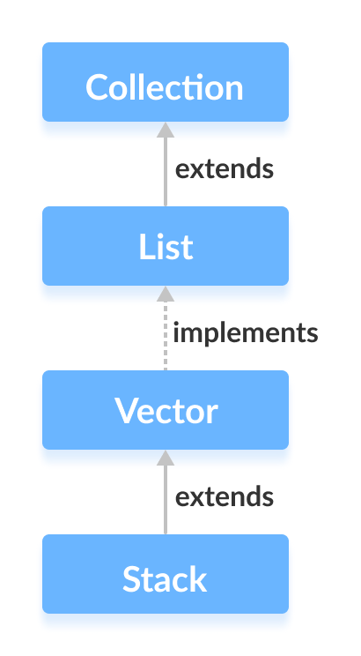
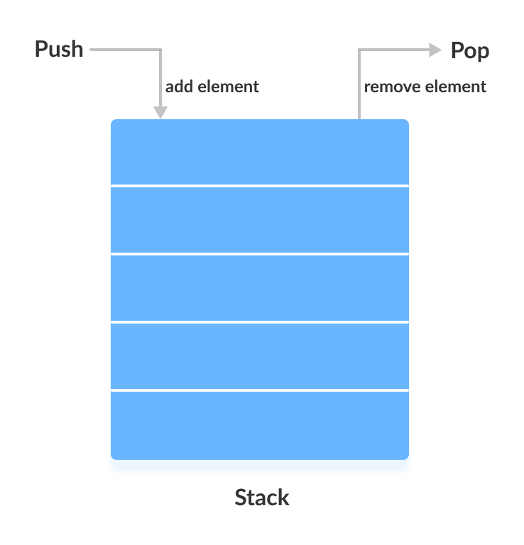
Java Stack Class
The Java collections framework has a class named Stack that provides the functionality of the stack data structure.
The Stack class extends the Vector class.
Stack Implementation
In stack, elements are stored and accessed in Last In First Out manner. That is, elements are added to the top of the stack and removed from the top of the stack.
ACE Engineering College

Slide 40
Creating a Stack
In order to create a stack, we must import the java.util.Stack package first. Once we import the package, here is how we can create a stack in Java.
Stack<Type> stacks = new Stack<>();
Here, Type indicates the stack's type. For example,
// Create Integer type stack
Stack<Integer> stacks = new Stack<>();
// Create String type stack
Stack<String> stacks = new Stack<>();
ACE Engineering College

Slide 41
Java Comparator interface
Java Comparator interface is used to order the objects of a user-defined class.
This interface is found in java.util package and contains 2 methods compare(Object obj1,Object obj2) and equals(Object element).
It provides multiple sorting sequences, i.e., you can sort the elements on the basis of any data member for example, rollno, name, age or anything else.
Method | Description
public int compare(Object obj1, Object obj2) | It compares the first object with the second object.
public boolean equals(Object obj) | It is used to compare the current object with the specified object.
public boolean equals(Object obj) | It is used to compare the current object with the specified object.
ACE Engineering College

Slide 42
class Student{
int rollno;
String name;
int age;
Student(int rollno,String name,int age){
this.rollno=rollno;
this.name=name;
this.age=age;
}
}
import java.util.*;
class AgeComparator implements Comparator{
public int compare(Object o1,Object o2){
Student s1=(Student)o1;
Student s2=(Student)o2;
if(s1.age==s2.age)
return 0;
else if(s1.age>s2.age)
return 1;
else
return -1;
}
}
ACE Engineering College

Slide 43
ACE Engineering College

Slide 44
ACE Engineering College

Slide 45
ACE Engineering College

Slide 46
ACE Engineering College

Slide 47
ACE Engineering College

Slide 48
ACE Engineering College

Slide 49
ACE Engineering College

Slide 50
ACE Engineering College

Slide 51
ACE Engineering College

Slide 52
ACE Engineering College

Slide 53
ACE Engineering College

